Slide 1
GO Team Dunbar ES 11/21/2024
Where we are – Where we’re going

Slide 2
Where We Are
Our strategic plan is the guide for the work we’re doing in the school. By monitoring the plan and ranking priorities, we can all work towards the common goals. Using the priorities in the strategic plan, the school leadership team developed a Continuous Improvement Plan (CIP) for the current school year.

Slide 3
Timeline for GO Teams
You are HERE
Fall 2021
GO Team Developed 2021-2025 Strategic Plan
1
Summer 2024
School Leadership completed Needs Assessment and defined overarching needs for SY22-23
2
August 2024
School Leadership completed 2024-2025 Continuous Improvement Plan
3
Sept. – Dec. 2024
Utilizing current data, the GO Team will review & possibly update the school strategic priorities and plan
4
Before Winter Break
GO Team will take action (vote) on the rank of the strategic plan priorities for SY24-25 in preparation for budget discussions.
5

Slide 4
Discussion Items
Current Strategic Plan
Georgia Milestones Math Data
Continuous Improvement Plan
Needs Assessment
SMART GOALS
Action Plan
Strategic Plan Alignment & Update
School Uniform

Slide 5
Current Strategic Plan
2021-2025

Slide 6
Mission Paul L. Dunbar is a school where excellence is expected, and all students are developed academically, socially, and emotionally in order to become globally competitive.
School Name: Dunbar Elementary School
Vision: Paul L. Dunbar Elementary is a school that nurtures and develops life-long learners who are problem solvers and internationally minded citizens.
SMART Goals
By May 2025, we will increase the % of students in grades 3-5 scoring proficient or above in reading by 5% from 22% to 27% and decrease students scoring beginning by 5% from 53% to 48% on MAP.
By May 2025, we will increase the % students in grades 3-5, scoring proficient or above in math by 5% from 10% to 15% and decrease students scoring beginning by 5% from 58% to 53%.
By May 2025, we will increase the % of CCRPI Attendance from 60% to 65%. (5% Growth)
APS Strategic Priorities & Initiatives
School Strategic Priorities
School Strategies
1.Offer an academically challenging curriculum that prepares students for college and career readiness
2. Effectively implement literacy curriculum to include explicit instruction
3. Effectively implement math curriculum
1A. Align the school schedule to create collaborative planning session for each teacher
1B. Aligned the instructional framework to maximize instructional time in the classroom.
1c.Integrate reading strategies and fluency facts into all exploratory courses
2a. Ensure all classroom are print –rich with Literacy Centers that focus on various reading skills
2b.. Ensure all classroom are using visual supports and engaging texts to increase literacy
3a 1Emphasize problem-solving strategies and encourage students to explain their reasoning
3b. Ensure Math Centers allows students to practice a variety of difference skills at their own pace
Fostering Academic Excellence for All Data
Curriculum & Instruction Signature Program
Building a Culture of Student Support
Whole Child & Intervention Personalized Learning
4. Effectively use existing and appropriate tools to measure, analyze, and communicate student progress
5. Effectively monitor attendance protocols and systems
6. Create a collaborative, inclusive, and responsive school culture
4a.. Complete ongoing data protocol with teachers during collaborative planning
4B. Use if frequent common assessments , analyze date, use to guide instruction
6a .Integrate SWD professional learning to structure special education instructional framework
4c/5b. Implement a school wide behavior plan (PBIS focused) / Implement attendance Incentives
Equipping & Empowering Leaders & Staff
Strategic Staff Support Equitable Resource Allocation
7. Build teacher capacity to meet the academic needs of the students
8. Create a Supportive Work Environment that motivates and retains staff.
6a.. Implement and Monitor professional learning collaborative planning to review instructional framework
6b. Continue to build instructional teams to support the teachers and students
7a .Integrate SEL Awareness and moment to build positive work environment
9. Provide necessary resources to enhance teaching and learning in all spaces
10. Attract and build capacity of talented and knowledgeable staff to meet school needs
11. Build and sustain parent engagement, community partnerships, and student voice
8a.. Implement Wellness Days and celebrate teachers and staff for attendance, data, personal accomplishments
9a. Increase math manipulatives, literacy manipulatives, and reading centers
10a Encourage Endorsements in Reading, math, technology to increase professional knowledge.
11a. Build and sustain parent engagement, community partnerships, and student voice
Creating a System of School Support
Strategic Staff Support
Equitable Resource Allocation
TBD: tbd
14

Slide 7
Data Math Data will be available Dec. 6th

Slide 8
Continuous Improvement Plan

Slide 9
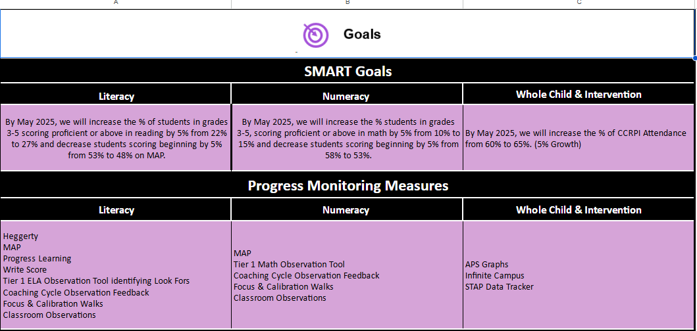
School Name
Needs Assessment
Strengths | Opportunities/Challenges
Jamboard Link Here
Notes:
Notes for School CIP Teams: After completing your Comprehensive Needs Assessment ( data protocol), you will come here and identify some strengths and opportunities/challenges you have observed from the data. The priority areas are Literacy, Numeracy, and Whole Child & Student Support. Identify an overarching need for each area. Formulate a problem statement for each area. Make sure the problem statement meets the criteria. Refer to your CIP resources.

Slide 10
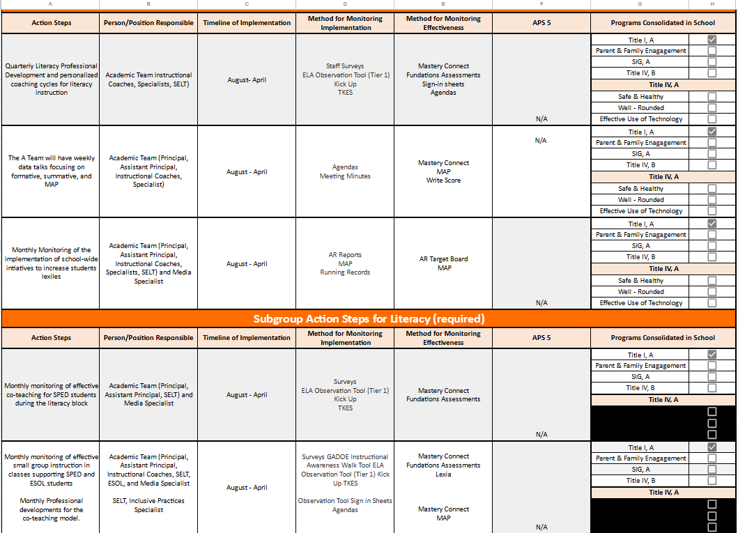

Slide 11
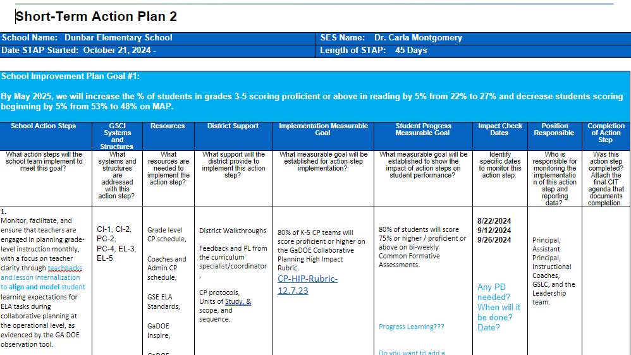

Slide 13
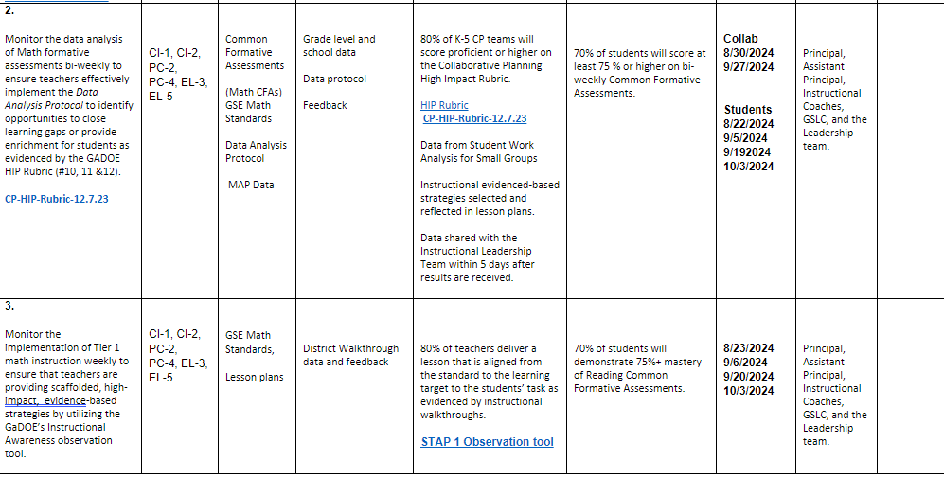

Slide 14
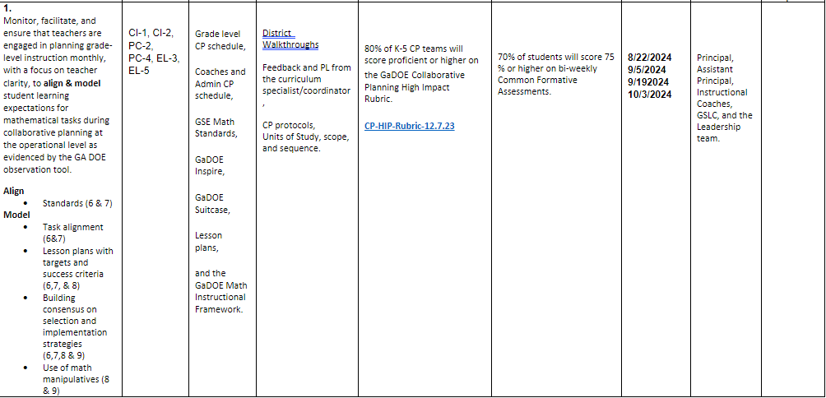

Slide 17
Activity & Discussion
GO TEAM DISCUSSION: Review the priorities and goals in your strategic plan and reflect on if the expected progress is being made. These guiding questions will help you determine what, if any, updates are needed for your school’s strategic plan.
What progress has been made towards the priorities identified in our Strategic Plan? What evidence/data do we have?
Literacy: In progress- data is improving groups have been adjusted to meet the needs of the students. Resource: FlyLeaf, Fundations, and Reading Specialist
Based upon available data, are there any other adjustments we need to make to the Strategic Plan?
Adjustments are made weekly based on CFA data and STAP Monitoring by District, State, and RESA
Math: In progress –data is improving groups have been adjusted to meet the needs if the students: Math Specialist and groups
Attendance Goal: Met ( Will continue Attendance Protocols)

Slide 18
Updates to the
Strategic Plan
STAP (45- days) The STAP is created every 45 das based on the data from the following: Collaborative Planning (HIPP Rubrics), SDI Rubric (State)- Classroom Observations, and CFA Data
Winter MAP will determine STAP 3

Slide 19
Preparing for Budget Development

Slide 20
Discussion
Strategic Plan Priority Ranking
In preparation for the 2025-2026 Budget Development (January–March 2025), the GO Team needs to rank its Strategic Plan Priorities. Use the next slide to capture the priority ranking.

Slide 21
Strategic Plan
Priority Ranking
Attract and build capacity of talented and knowledgeable staff to meet school needs.
Ensure a safe and effective learning environment that encourages the use of an instructional framework utilized across all content areas for more personalized learning.
Offer an academically challenging curriculum that prepares students for college, career, and citizenship.
Ensure that all students learn about multiple topics from a variety of different viewpoints.
Build teacher capacity with the ability to meet the diverse social and academic needs of students.
Create a collaborative, inclusive, and responsive school culture embracing the diverse communities that comprise the Dunbar ES family.
Create an environment that motivates and retains staff members.
Effectively use existing and appropriate tools to measure, analyze, and communicate student progress.
Provide necessary and salient resources to enhance teaching and learning in all spaces.
Attract and build capacity of talented and knowledgeable staff to meet school needs.
Build and sustain parent engagement, community partnerships, and student voice.
Higher
Lower

Slide 22
Action on the Strategic Plan Priorities
The GO Team needs to TAKE ACTION (vote) on its ranked Strategic Plan Priorities. After the motion and a second, the GO Team may have additional discussion. Once discussion is concluded, the GO Team will vote.

Slide 23
Where we’re going
At our next meeting we will begin the discussion of the 2025-2026 budget.
Let me or the Chair know of any additional information you need for our future discussion.

Slide 24
ENROLLMENT
Projected Enrollment | 256
Projected Enrollment for 2024-2025 | 206
Difference | 50
*The budget adjustment reflects the impact of the following: enrollment changes, FY25 reserve, adjustments to Title I, Family Engagement and School Improvement Allocations, Security Grants and FY24 carryover funds
Notes:
Principals: Based on your15-Day count, please give your GO Team an overview of your projected vs. 8/21 enrolled numbers as well as information on your FY25 budget adjustment.

Slide 25
FY2025 Leveling Change Request
Leveling Change at Base Weight $5,334 |  | $234,696
School Reserve Funds |  | $23,439
Title I Adjustment |  | $3,306
 | Family Engagement Adjustment | $-
 | School Improvement Adjustment | $(150,000)
 | School Security Grant | $45,000
 | FY24 GF Carryover | $-
Total Adjustment |  | $156,441

Slide 26
Plan for FY25 Leveling Reserve
$23367 (Reserve) $156,444- 45,000 (Sg)
Priorities | APS FIVE Focus Area | Strategies | Requests | Amount
Increase Literacy | Building a Culture of Student Support Whole Child & Intervention Personalized Learning | Increase the number of books in media center Increase book circulation to increase literacy | *Leveled Libraries *Independent Reading | $28,590
Increase Literacy | Building a Culture of Student Support Whole Child & Intervention Personalized Learning | Provide each classroom with a classroom library to increase independent reading; variety of text | * Classroom Libraries | $30, 000
Interventions and Small Group Instruction | Building a Culture of Student Support Whole Child & Intervention Personalized Learning | Maximizing student learning opportunities | Test: Decodables for Classroom libraries. Purchase books for book vending machine | $25, 665
 |  |  |  | $84,255
Notes:
Review the previously discussed plan for the FY25 Leveling Reserve as discussed by the GO Team in your Feb. 2024 Budget Feedback meeting and March 2024 Approval meeting.

Slide 27
Security Grant Funds $45K
Security Approved Item | Cost
13 Security cameras- Indoor and Outdoor the School- Playground Area, Parking Lot, | $24,855
Lights- Playground Area- Walking Path | Expecting Estimate this week- $ 20K
Radios | Will use any remaining money to update School radio

Slide 28
Discussion
Strategic Plan Priority Ranking
In preparation for the 2025-2026 Budget Development (January–March 2025), the GO Team needs to rank its Strategic Plan Priorities. Use the next slide to capture the priority ranking.

Slide 29
Principal’s Report

Slide 30
Thank you

